Slide 1
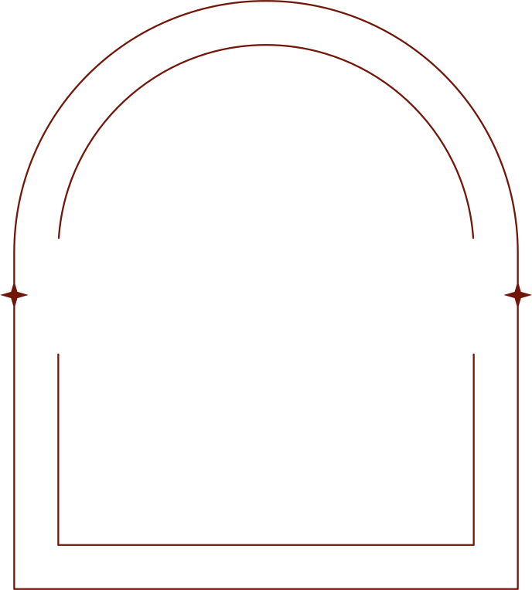

J A M
JOB ACHIEVER
MASTER
No more lack of courage and mess
in the job application process !

Slide 2

INTRODUCTION
This app helps jobseekers
to speed up and make the application process easier by creating for them the perfect CV/cover letter,
send them to the employer by email
and simulate the following job interview.

Slide 3

Have you ever noticed
how much time you need
to modify your basic CV to highlight
the requested skills every time
you start to make an application
for a new job?

Slide 4

And what about writing
a personalised cover letter?!
Then you have to log into your email provider, insert the address of the employer, compose the text, attach the documents and send the email...
once again...

Slide 5

If you are skilled (and lucky) you might receive a call back...but, among the tens of applications you sent, what was this particular job about? Had you saved the job description? And where? Was it in Linkedin or in Stepstone?

Slide 6

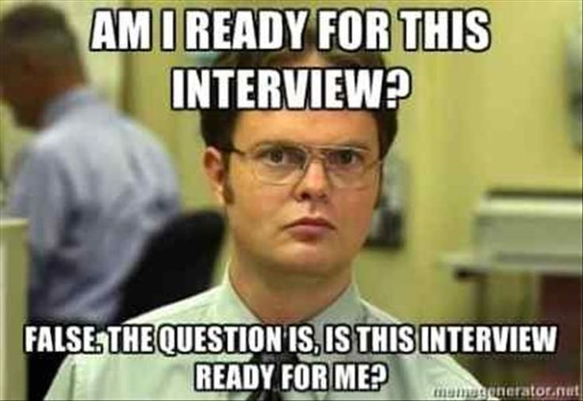
WHAT ABOUT
IF YOU HAD AN APP WHICH NOT ONLY DOES ALL THAT,
BUT IT ALSO HELPS YOU TO PREPARE FOR THE JOB INTERVIEW?!

Slide 7

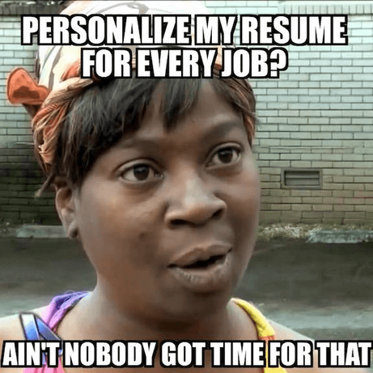
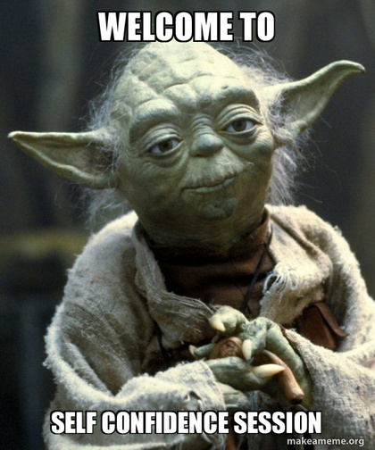
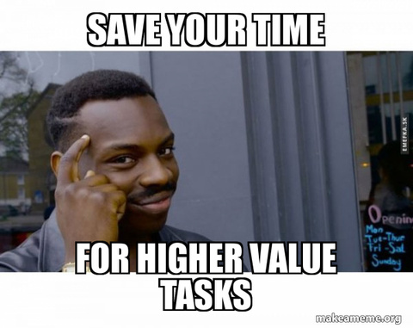
THAT'S WHY WE CAME UP WITH THE IDEA OF JAM,
YOUR JOB ACHIEVER MASTER!!!
YOU
CAN SAVE TIME
AND NEURONS
MORE
PROFESSIONAL CV/COVER LETTER...
MORE
RELAXED AND PREPARED
FOR JOB INTERVIEWS

Slide 8
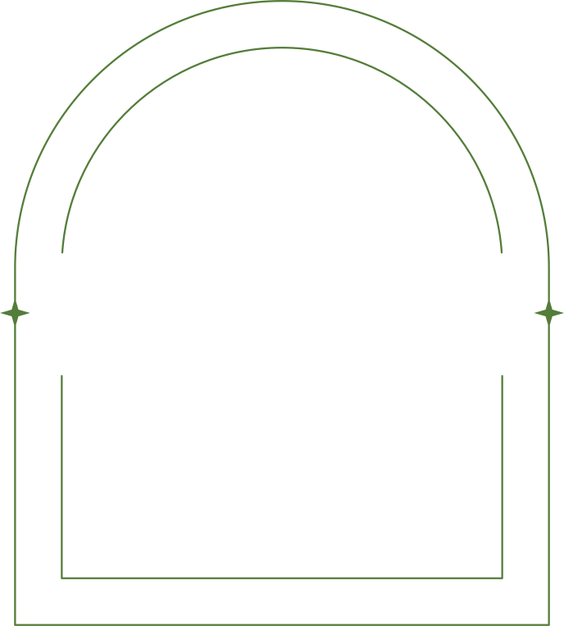

THANK YOU
by
Arpaia G., Pogrebnyak K.,
Radu A., Zamai S.

